Slide 1
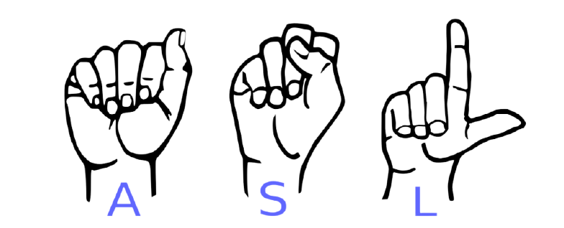
SIGN LANGUAGE RECOGNITION
USING MACHINE LEARNING TECHNIQUES
Gunjan Agarwal
Ishan Ahmed
Tamim Ahmad
Sudarshan Tarmale
Guided by Prof. Saiqa Khan

Slide 2
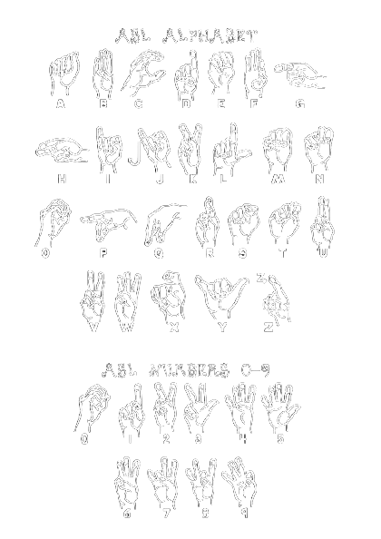
SIGN USED IN ASL

Slide 3
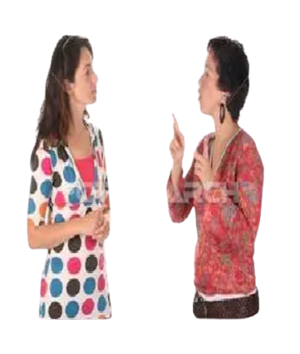


INTRODUCTION
Sign language is a tool for deaf and dumb people to communicate with the world.
In recent years, technologies like gesture recognition, facial recognition have received huge importance under the branch of sign language.
In sign language, every sign has its meaning.
The sign language used by people must be translated into some text, which can be further understood and interpreted by normal people.
Gesture recognition curtails the difficulty to communicate with the deaf, as it returns output in text format.

Slide 4

OUR WORK
We propose a system using Sign language recognition which can be implemented in the following way -
Platforms used for conducting virtual meet.
Example- Google meetings, Zoom, etc.
It can be implemented in an app which will perform the task of converting sign language spoken by the dumb and deaf people to language which can be understood by the normal people.

Slide 5

RESEARCH GAPS
The features of ASL are all of right hand only. There is no provision for left hand.
The model showed less performance when the distance between the camera and the object is not considerable.
The detection and recognition were less when the hand was moved at a fast pace.
The dataset is limited to 9 hand gesture only.
FCM is efficient, it requires more computation time than the others.
The system is limited to only 6 hand gestures
There are some limitations, which are needed to be addressed. Recognizing a greater number of gestures would be helpful for performing more tasks

Slide 6
FLOW OF SYSTEM
Collect Images
Label Images
Create Label Map
Train Model
Detect
Create TF-Records

Slide 7
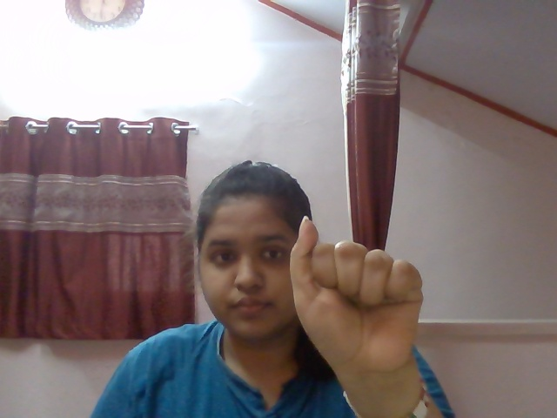
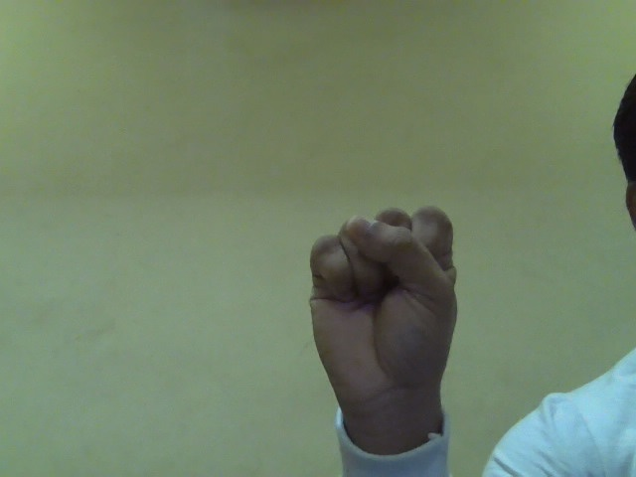

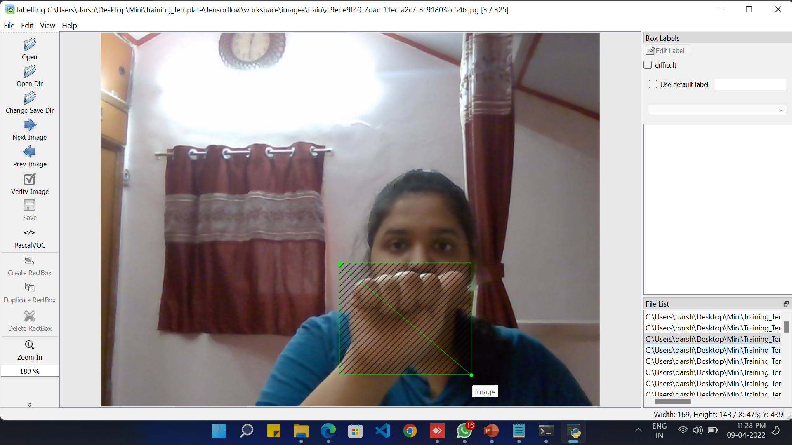
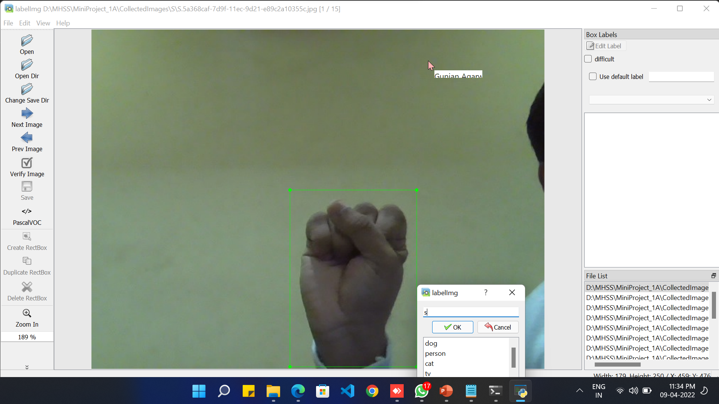
Dataset:
1. Collecting images of signs –
A
S
L
2. Labelling the images -

Slide 8

HARDWARE AND SOFTWARE DETAILS
Hardware | Web cam, laptop
Coding language | Python
External tools | Tensorflow-1.15.0, OpenCV Keras-2.1.6 h5py-2.10.0 Pycocotools Pandas
System Requirement | Python 3.5–3.7 pip 19.0 or later Microsoft Visual C++ Redistributable for Visual Studio 2015, 2017 and 2019 Windows 7 or later (64-bit) GPU support requires a CUDA®-enabled card (Ubuntu and Windows)

Slide 9
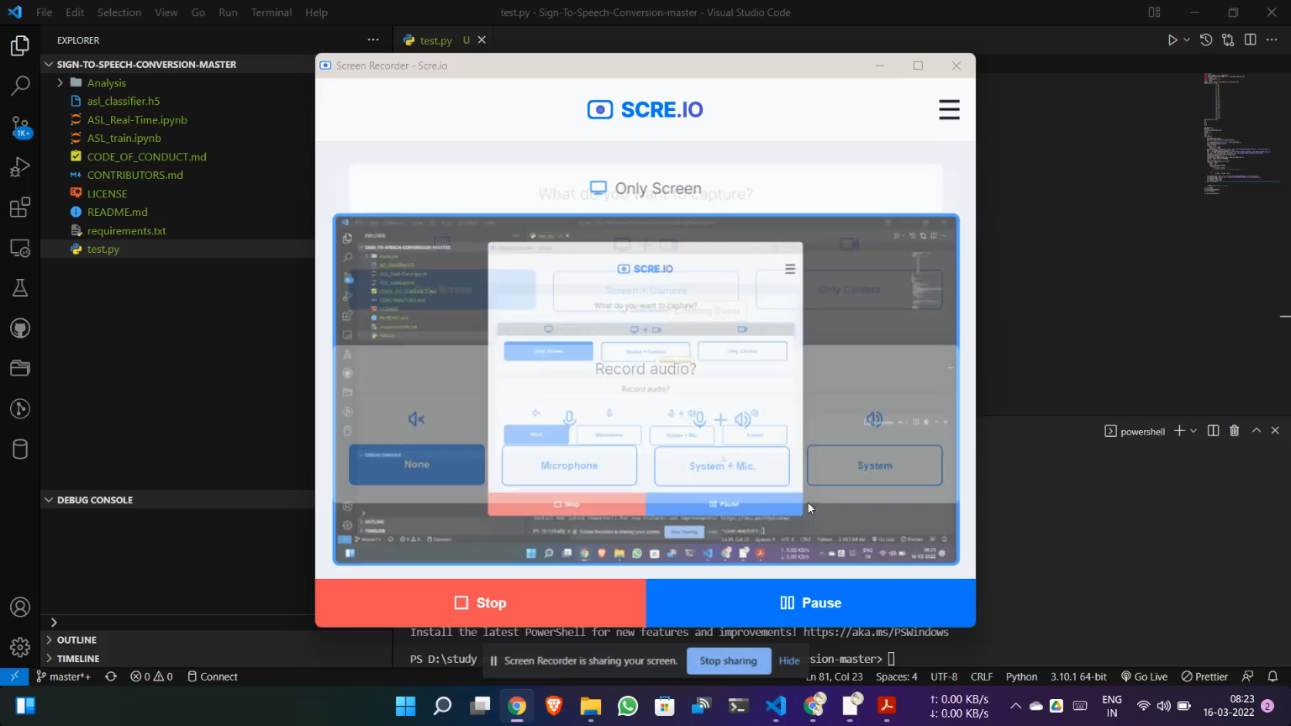
Demo:

Slide 10

CONCLUSION AND FUTURE WORK
This system is for people who cannot use gloves, sensors and other highly refined equipment.
The aim of this paper is to help and serve the deaf of our society to communicate with normal people.
We can develop a system that is two-way system where, conversion of sign to text and text to sign is possible.
Developing a system, where interpretation involves dynamic gestures.
Implementation can extend to mobile phones.

Slide 11
REFERENCES
[1] Amrutha K et al " ML Based Sign Language Recognition System" ©2021 IEEE | DOI: 10.1109/ICITIIT51526.2021.9399594
[2] Sona Shrenika et al “Sign Language Recognition Using Template Matching Technique” ©2020 IEEE | DOI: 10.1109/ICCSEA49143.2020.9132899
[3] Diksha Hatibaruah et al "A Static Hand Gesture Based Sign LanguageRecognition System using Convolutional NeuralNetworks" ©2020 IEEE | DOI: 10.1109/INDICON49873.2020.9342405
[4] Qinglian Yang et al "Leap Motion Hand Gesture Recognition Based on Deep Neural Network," ©2020 Chinese Control And Decision Conference (CCDC), 2020, pp. 2089-2093, DOI: 10.1109/CCDC49329.2020.9164723.
[5] H. Muthu Mariappan et al "Real-Time Recognition of Indian Sign Language," ©2019 International Conference on Computational Intelligence in Data Science (ICCIDS), 2019, pp. 1-6, DOI: 10.1109/ICCIDS.2019.8862125.
[6] Saransh Sharma et al "A Static Hand Gesture and Face Recognition System for Blind People," ©2019 6th International Conference on Signal Processing and Integrated Networks (SPIN), 2019, pp. 534-539, DOI: 10.1109/SPIN.2019.8711706.
[7] Hung-Yuan Chung "An Efficient Hand Gesture Recognition System Based on Deep CNN," ©2019 IEEE International Conference on Industrial Technology (ICIT), 2019, pp. 853-858, DOI: 10.1109/ICIT.2019.8755038.
[8] Felix Zhan, "Hand Gesture Recognition with Convolution Neural Networks," ©2019 IEEE 20th International Conference on Information Reuse and Integration for Data Science (IRI), 2019, pp. 295-298, DOI: 10.1109/IRI.2019.00054.

Slide 12

